Slide 1

HackerZGuide
The Ultimate Guide for Your Future Achievements…..
By CtrlC+CtrlV

Slide 2
INTRODUCTION
CtrlC+CtrlV
Shuvadeep Mondal 20221022 CSE
Tuman Sutradhar 20223045 IT
Pujan Sarkar 20221011 CSE

Slide 3
CONTENTS OF THIS TEMPLATE
Mission statement & our introduction.
The reason behind this project.
The Architectural diagram & Technology of our project
Advantage of our project.
Our Project .
Business overview & future .
Resources.

Slide 4
HackerZGuide
HackerZGuide is a website which will help the Beginners to choose their domain.

Slide 5
For Helping Beginners
Anyone can join
01
04
Giving a Platfrom
Connecting Community
02
05
Value for Money
Business
03
06
It will help beginners for Exploring & learning about many new domains
Anyone can join from any domain any stream any courses .
We are giving a proper platfrom for guidence
In future we can connect so many community togethers.
All the resources will be free
In future we can grow this in a proper business model

Slide 6
03
Architectural diagram & Technology

Slide 7
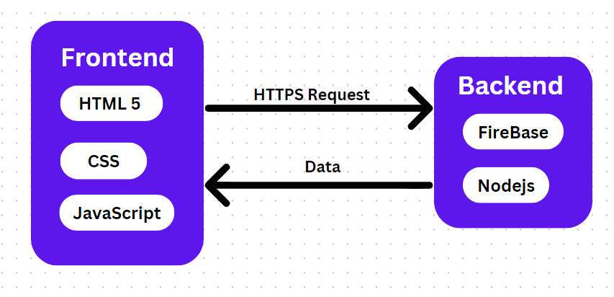
Architecture/Model Diagram
Technology
we are using HTML5 , CSS , JavaScript in Frontend and using FireBase & Nodejs in backend

Slide 8
PROBLEM VS. SOLUTION
Problem
Solution
In the beginning many students would be confused about which domain they will choose , which domain will be perfect for them
This site will give a proper guidance throughout the session and it will help them

Slide 9
Avalability
Web
Android

Slide 10




ADVANTAGES
EASY TO USE
Great resources
USER FRIENDLY
Powerful settings
Refferences for hackathons courses,Internship oppurtunity

Slide 11
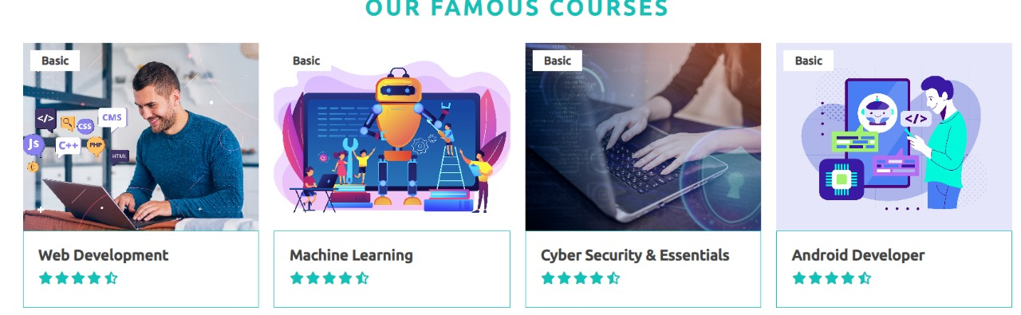
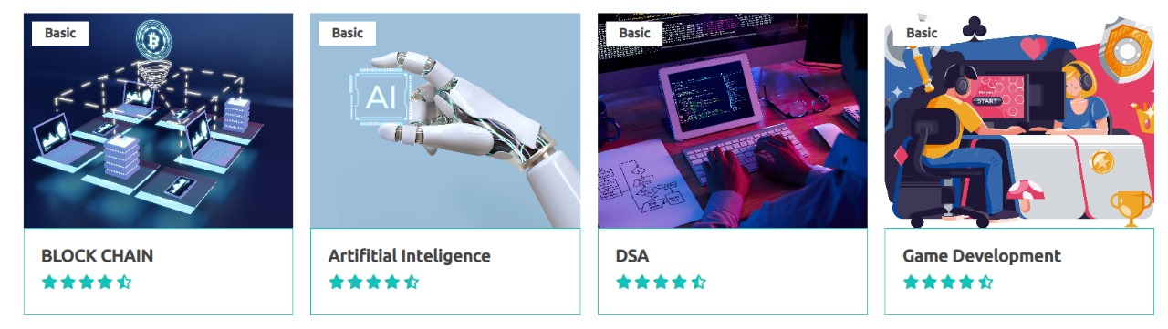
DOMAINS

Slide 12
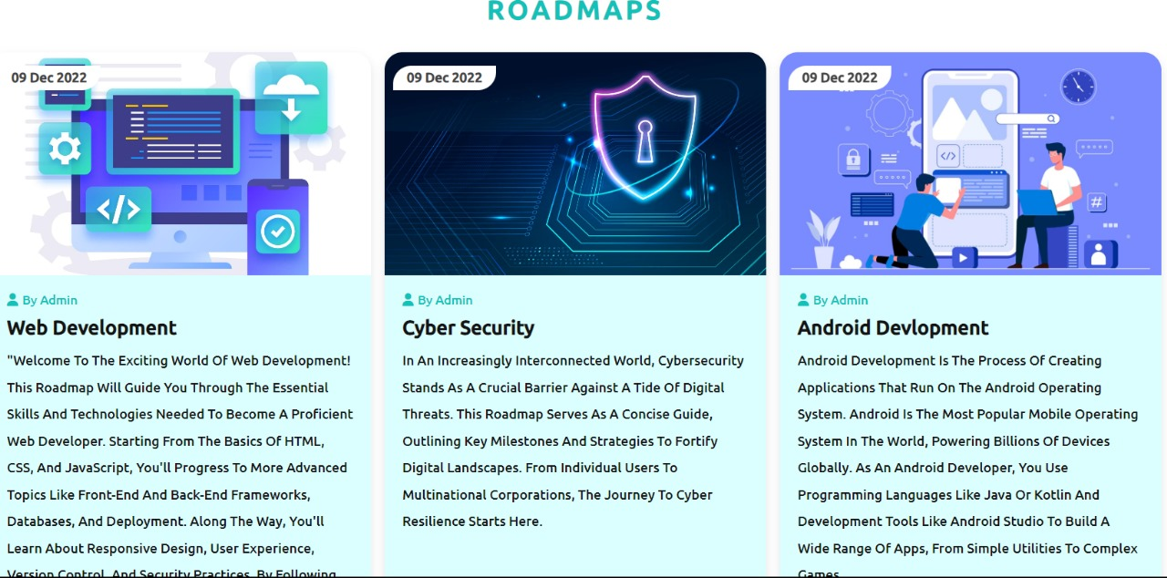
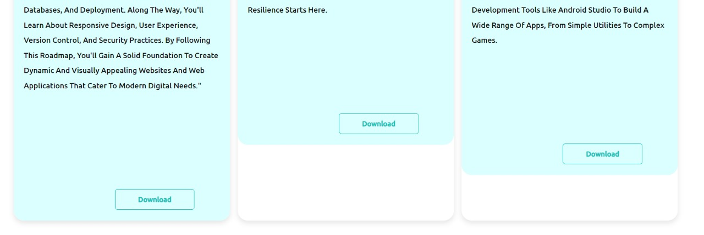
BREAK-EVEN ANALYSIS

Slide 13
FUTURE PLAN
Backend will be completed
There will a dashboard for user.
Some things will be upgraded .
Practise Sets will be available on user choosen domain.
little amount of Subscription.

Slide 14

OUR PROGRESS: PREVIOUS TOPIC ARE OUR FRONTEND BACKEND IS NOW NOT AVAILABLE . WORKING IS GOING ON IT

Slide 15

THANK YOU
Any Query :
Contact With >>sutradhartuman@gmail.com

